Slide 1
Analysis of LAB dataset
Toxicity Grades
Release Date: DD-Mmm-YYYY

Slide 2
Agenda
NCI CTC Grades
Understanding Grades
Example of CTC Grades
Sample code for CTC grades
Challenges and solutions
Reference paper for reading

Slide 3
NCI CTC Grades
One of the key ways of analyzing laboratory data includes classifying results into severity grades based on National Cancer Institute (NCI) Common Terminology Criteria (CTC) for Adverse Events.
While most clinical trials report laboratory results based on normal range criteria (is the result lower or higher than what is considered “normal”), oncology trials take that analysis to the next degree of specificity.
It is not enough to report where select laboratory results are too high or too low, it is important to report the degree of “lowness” or “highness.”
For example, if a patient’s hemoglobin results are 6.0 mmol/L, is that merely abnormal or is the patient near death?
In an indication such as oncology where patients are often expected to have abnormal laboratory results, it is important to know how abnormal the abnormal result actually is.

Slide 4
Understanding Grades
Events are graded on a scale of one to five with one meaning “mildly abnormal” and five meaning “death.”
When applying these grades to laboratory results, grade zero is often used to indicate “normal” or “not a concern” while grade five is not applicable.
It is important to note that not all laboratory tests have CTC grade criteria available.
In addition, some laboratory tests provide two sets of grades – one set for values that are too low and another set for values that are too high.
It is also worth noting that the criteria are not all defined in the same way. Some criteria are simply multiples of the upper or lower bound of the normal range, as for the term Creatinine increased, while others combine normal range limits with fixed values as the other terms above.

Slide 5
Grades
Grade 1-> Mild; asymptomatic or mild symptoms; clinical or diagnostic observations only; intervention not indicated.
Grade 2-> Moderate; minimal, local or noninvasive intervention indicated; limiting age-appropriate instrumental ADL*.
Grade 3-> Severe or medically significant but not immediately life-threatening; hospitalization or prolongation of hospitalization indicated; disabling; limiting self care ADL**.
Grade 4-> Life-threatening consequences; urgent intervention indicated.
Grade 5-> Death related to AE.
Activities of Daily Living (ADL) *Instrumental ADL refer to preparing meals, shopping for groceries or clothes, using the telephone, managing money, etc.
**Self care ADL refer to bathing, dressing and undressing, feeding self, using the toilet, taking medications, and not bedridden.

Slide 6
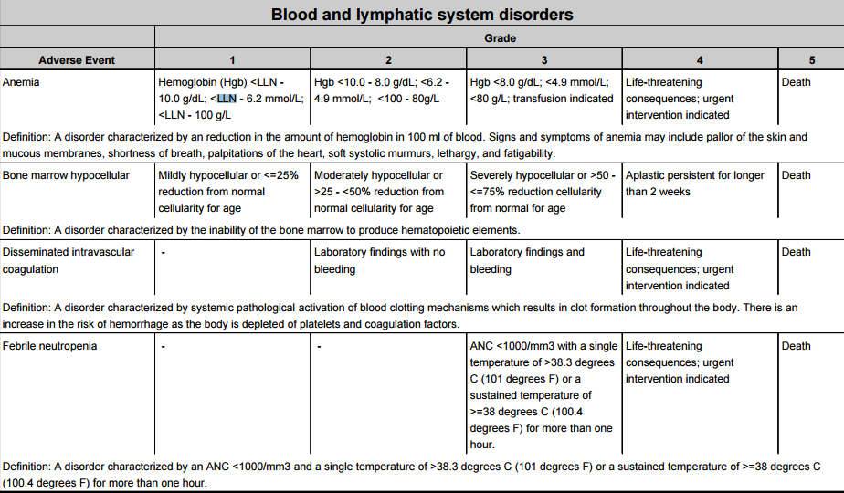
Example of CTC grades

Slide 7
Programming using SAS
One example of a simple approach to assigning CTC criteria for three tests (calcium, creatinine, and platelets) is presented below.
The key variables in the labs data set are as follows:
lbtest : The name of the laboratory test
☞ lbstresn: The laboratory result in standard units
☞ lbstresu: The name of the unit for lbstresn
☞ lbstnrlo: The lower bound of the normal range
☞ lbstnrhi: The upper bound of the normal range.
Lbstresn, lbstnrlo and lbstnrhi are all numeric variables reporting values in the same unit (as indicated by lbstresu).
☞ Lbtoxgr is the name of the variable that will contain the CTC grade.

Slide 8
Sample code for CTC grading

Slide 9
Challenges and Solutions
DIFFERENT UNITS OF MEASURE
Solution: Ensure that results are converted in standrad unit of reporting before you apply CTC grade criteria.
MISSING NORMAL REFERENCE RANGES
Solution: Many CTC criteria use the lower (LLN) and/or upper (ULN) bounds of the normal range and this missing information may prevent CTC criteria from being applied. Based on the number of records with missing normal ranges, default normal ranges may need to be used in cases where the ranges from the local laboratory are not available.
ROUNDING WITH UNIT CONVERSION
Solution: When converting results from one unit to another, the new result will often have many more decimal places than the
original. It is rare for summary reports to show results with more than three decimals, often two decimals is the maximum shown. It is important to decide if converted results should be rounded before or after applying CTC criteria as it can affect how the data are reported.

Slide 10
Challenges and Solutions (Contd…)
OVERLAPPING RANGES
Problem: One particularly tricky issue pertains to CTC criteria which mix normal ranges with fixed values. In these cases, it is
possible that the normal range values equal or overlap the CTC criteria bounds. For example, the bounds for platelet
grade one are >= 75 x 103/UL to LLN – what if the LLN for a particular laboratory is 75? That would make the bounds
for grade one 75 to 75 and the bounds for grade two 50 to 75. If a patient has a lab result of 75, that result may be
coded to either grade one or grade two if the method of assigning grades does not take this into account.
Solution: Check with your study team about how you want to report this

Slide 11
Challenges and Solutions (Contd…)
OVERLAPPING RANGES
Problem: In addition to normal ranges equaling CTC bounds, it is also possible for normal ranges to overlap CTC bounds.
Consider if the LLN for a calcium result is 7.89 mg/dL. This would make the boundary for CTC grade one be >= 8 to <7.89 while the boundary for grade two is 7 to <8. In this case, the LLN is actually within the grade two range boundaries.
Solution: In this case, the decision needs to be made whether CTC grade criteria override laboratory normal ranges or vice versa.
Note: Please read the reference paper attached in next slide for examples on challenges and solutions along with sample SAS code

Slide 12
Reference paper for Reading

Slide 13
Thank You

